Slide 1
Linear Regression
What is Linear Regression and how to train it

Slide 2
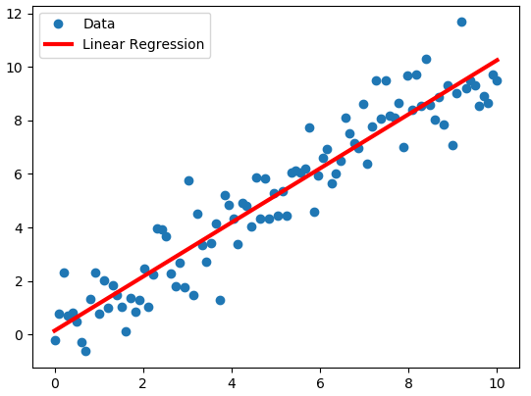
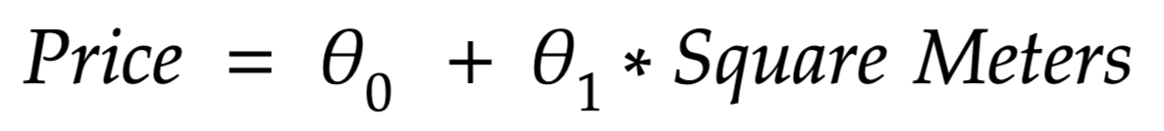
Example: price of the houses
We have many data about the prices of the houses in Boston. For each house, we have the area of the house, the number of bedrooms, if it has the garden or not...and for each house, the price ($).
We would like to estimate the a price given a never-seen-before area of the house.
Price (dollars)
Area of the house (m^2)
GOAL: find the function that, given the Area, give us the Price, also for value that the model never saw before. The function we have to find is the red one.

Slide 3
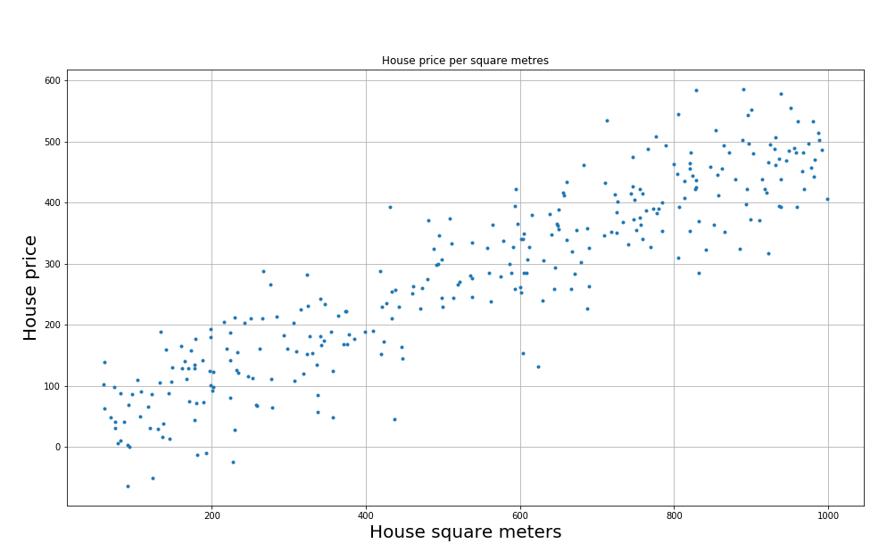

2-dimensional problem
We would like to find the best “line” (red in figure) that fits the data - as close as possible to data → find the best thetas values.

Slide 4
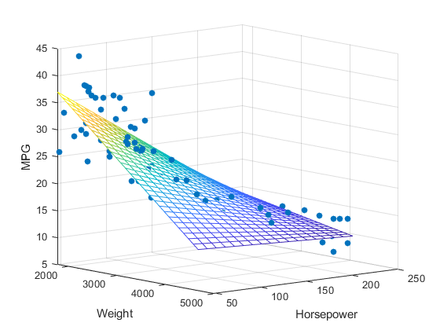

3-Dimensional problems
We have now a more complex problem.
The input values are
HorsePower of the car,
Weight of the car)
and the output is MPG values (Miles Per Gallon).
If the data lays on a 3d plane, the problem is linear and we can apply Linear Regression problem!

Slide 5

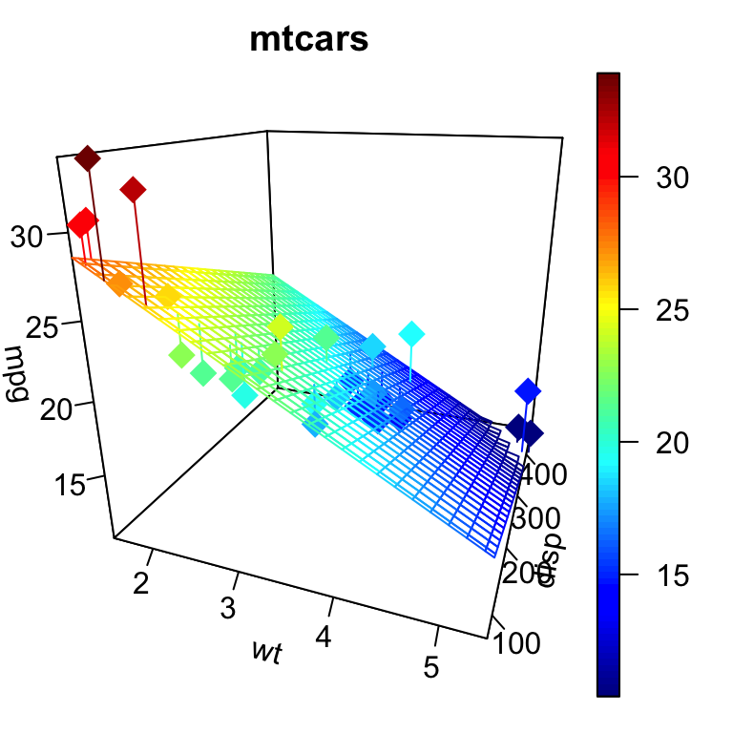
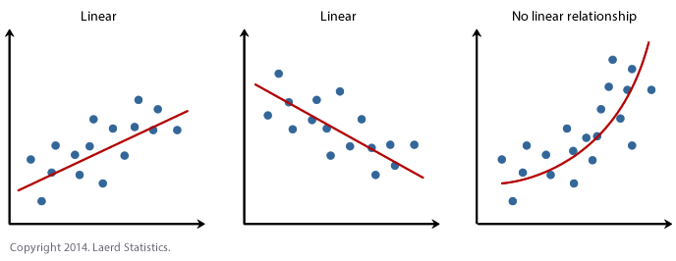
Why is it called “linear” ?
It is said “linear” because it is a linear combination of weights. It computes a “weighted sum” of the input features. Linear: NO ratio or multiplication of weights.
As a consequence, it can fit only data lying on a rect, a plane (in 3d), or hyperplane (in n-dimensions).

Slide 6
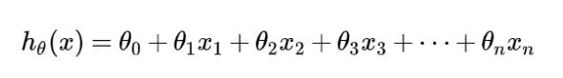
Linear Regression
First of all it is a regression: the target value (values to predict) are continuous (not categorical)
Second is Linear: this means that it is a linear combination of features with weights. It means that there are no multiplication or ratio between weights.
Hypothesis
IMPORTANT: there are no ratio (division) or multiplication between weights.

Slide 7
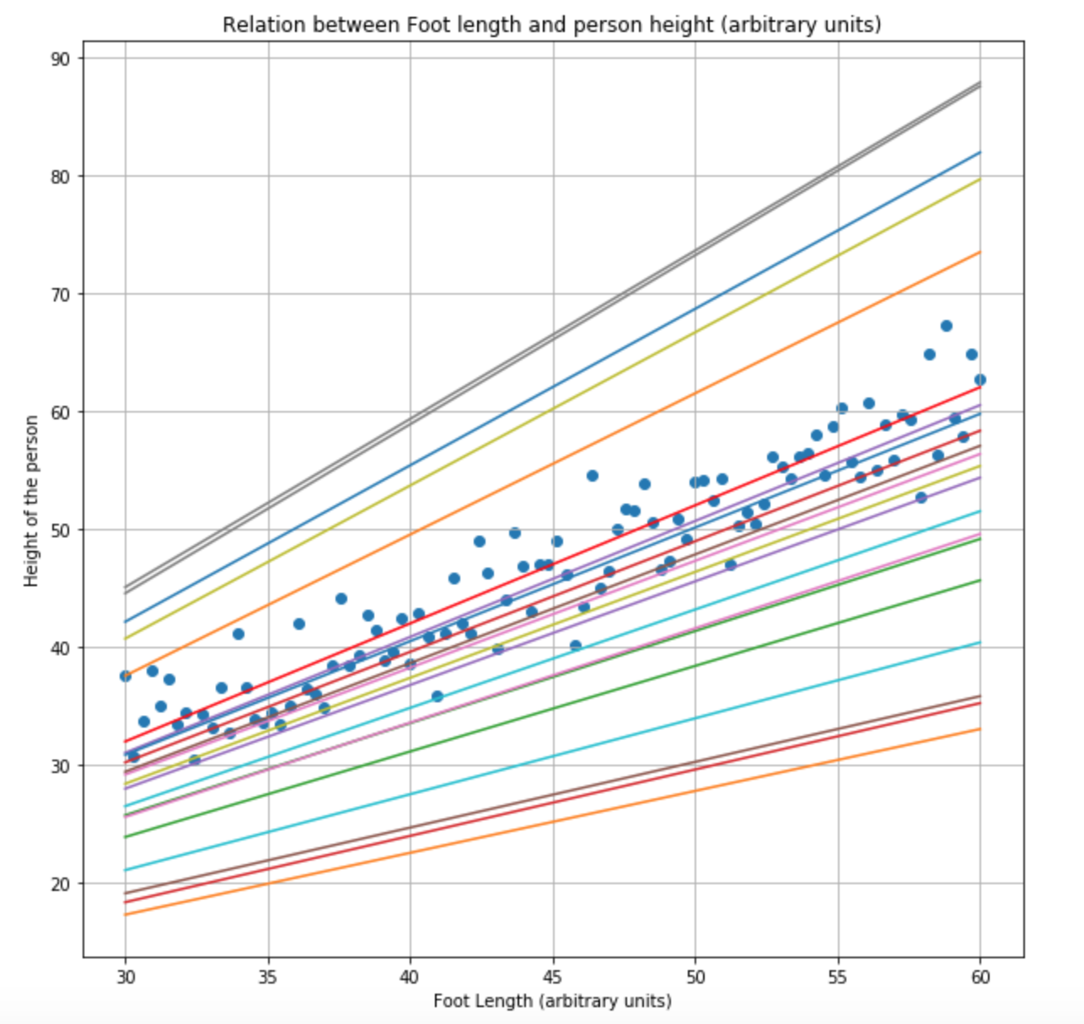
Back to 2D house problem
We have a lot of different (infinite) choices for and .
How do we choose the best alpha and beta?
We need to think about a measure telling us the “goodness of the fit”
(In regression, when a function represents the data it is said it “fits” the data)

Slide 8
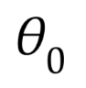
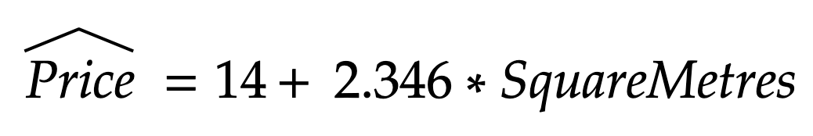
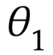
Back to 2D house problem
Suppose magically we have the function to describe data, like this one:
Price (dollars)
Area of the house (m^2)
We know that this is the equation of a rect, where we have a “bias term” (vertical translation 14) and a slope (2.346)

Slide 9
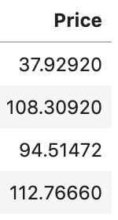
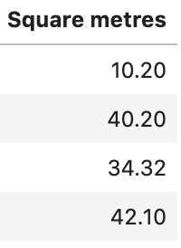
Back to 2D house problem
Suppose magically we have the function to describe data, like this one:
Price (dollars)
Area of the house (m^2)

Slide 10
It’s your turn!
Open file called: LinearRegression.ipynb with Jupyter Notebook
Complete the Section_1

Slide 11
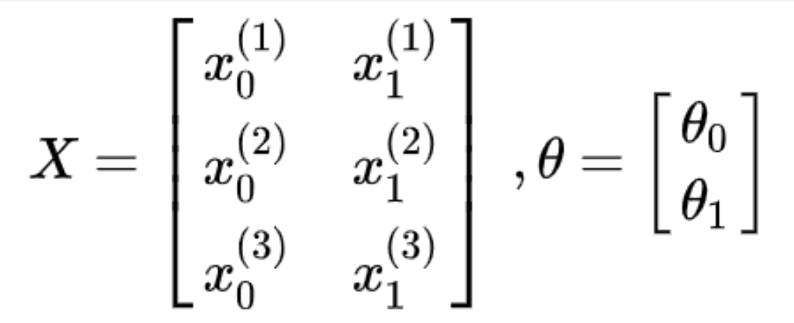
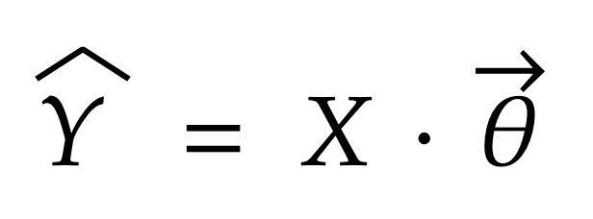
Some notations
Weights vector
Input matrix: each row is a sample

Slide 12
Methods used to solve linear regression
We have 2 mathematical methods:
Normal Equation
Gradient Descent

Slide 13
Normal Equation

Slide 14
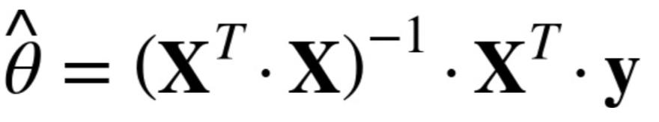
Normal Equation
There is a closed-form solution to the problem. “Closed solution” means that we have a formula to solve the problem and finding the best
Best Thetas to fit the data
Matrix of inputs
Vertical vector of PRICES

Slide 15
Gradient Descent

Slide 16
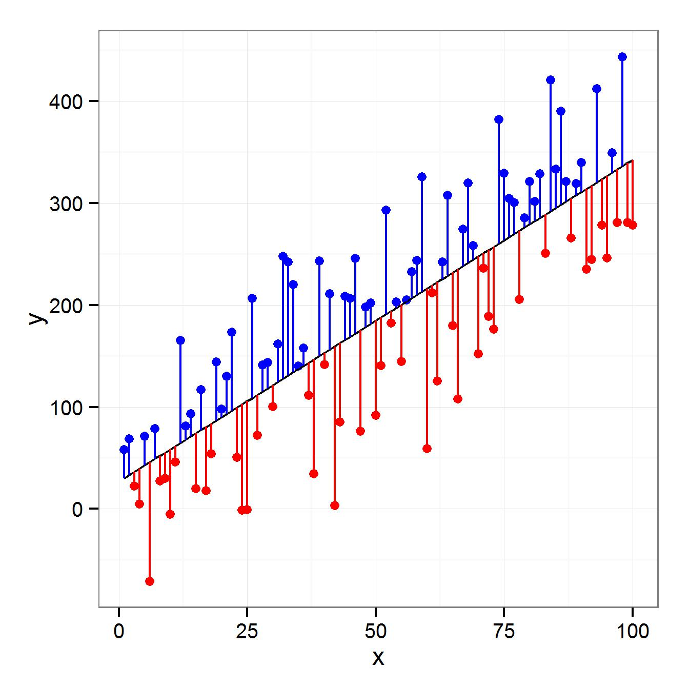
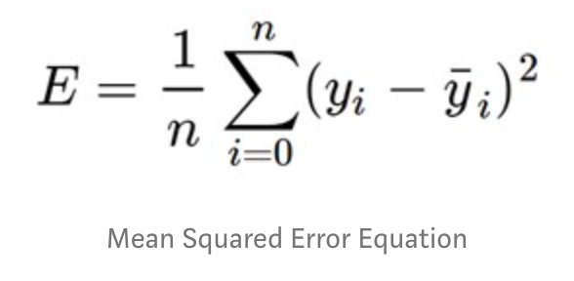
Measure of Error (Loss function J)
Errors
Mean Squared Errors (MSE)
Real Y
Predicted Y, calculated by linear model
TAKE AWAY MESSAGE: we have to choose the line as close as possible to data. Aka the line with the lowest possible total error

Slide 17
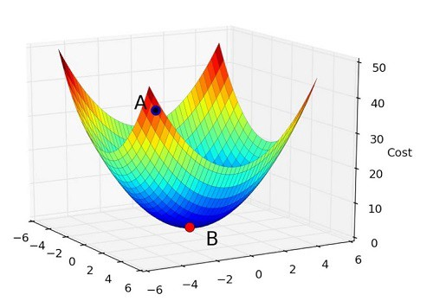
Gradient Descent Method - Optimization
The MSE function is quadratic. In general we call it “loss function” (J).
The goal is to optimize this function, reaching its minimum because this “bowl” describe the error varying m and q.
How? With Gradient Descent Method
q
m

Slide 18
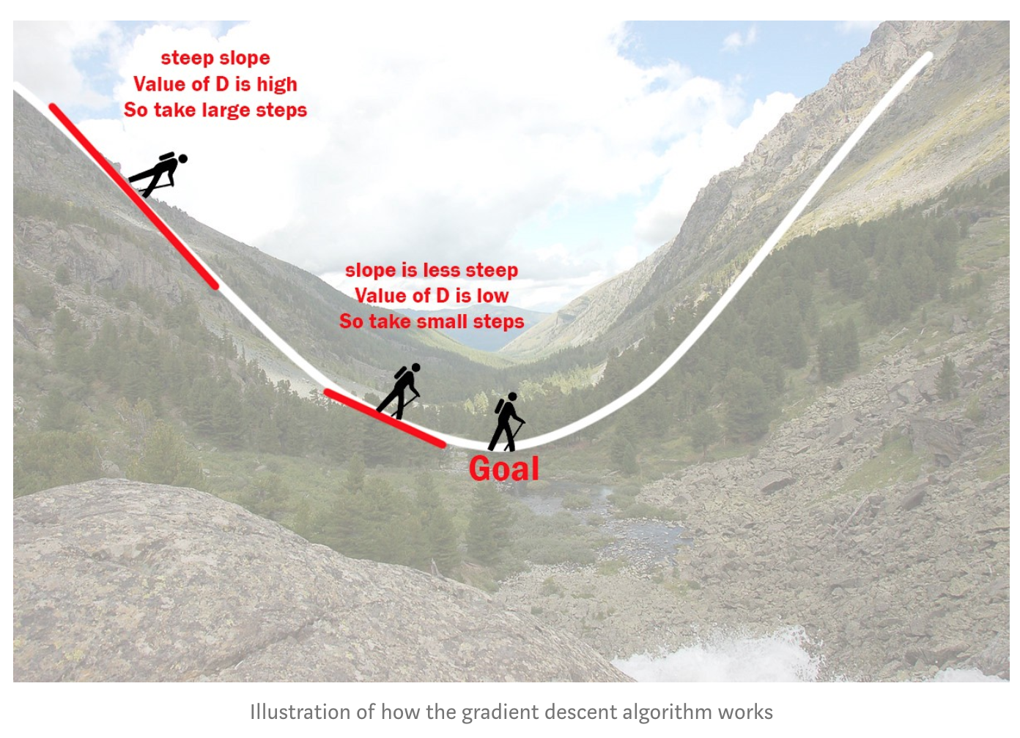
Gradient Descent Method

Slide 19


Global and local minima: like playing with a ball

Slide 20

Gradient Descent Method on generic function
LINK to animation

Slide 21
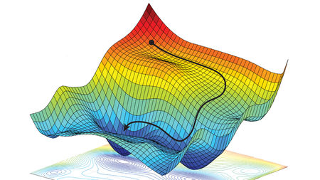
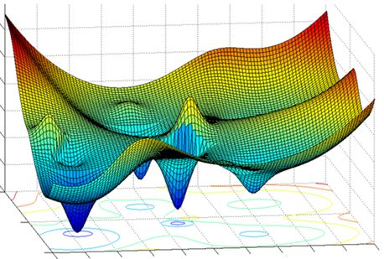
Other examples

Slide 22
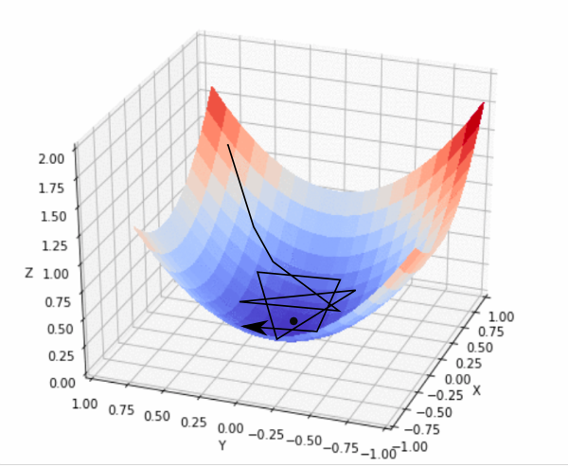

Gradient Descent Method: down the hill as fast as possible! ...and the problem is convex
STEPS of the algorithm
Initialize Theta0 and Theta1 randomly
Calculate the derivative (slope) on Loss function
Make a step downhill
Repeat until the minimum
Due to mathematical formulation of loss function in linear regression, we are sure there exists only 1 global minimum

Slide 23
Measure of Error (Loss function)
Errors
Mean Squared Errors (MSE)
Real Y
Predicted Y, calculated by linear model
TAKE AWAY MESSAGE: we have to choose the line as close as possible to data. Aka the line with the lowest possible total error

Slide 24
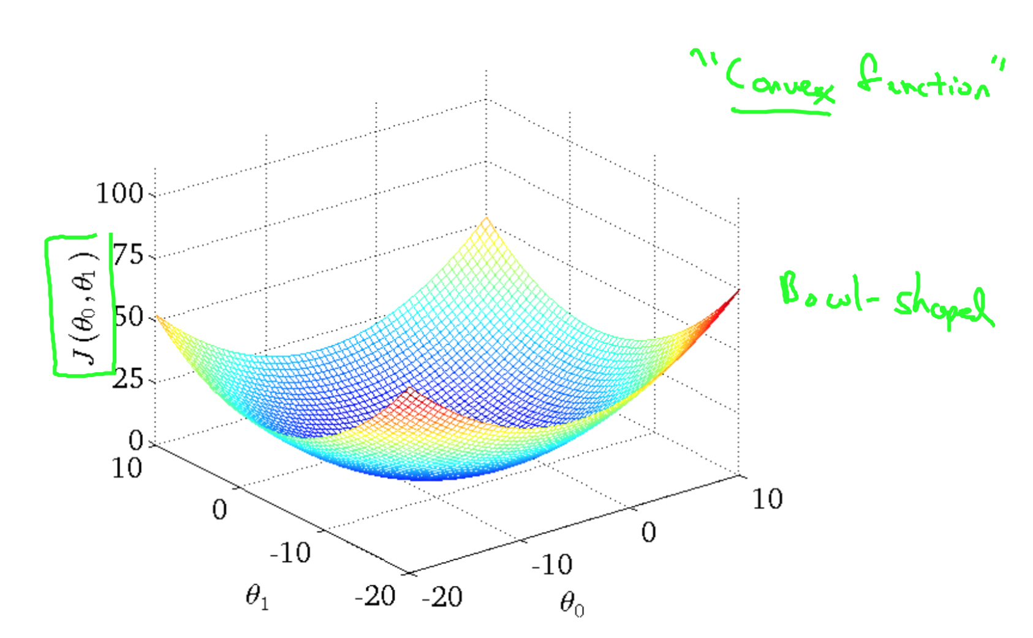
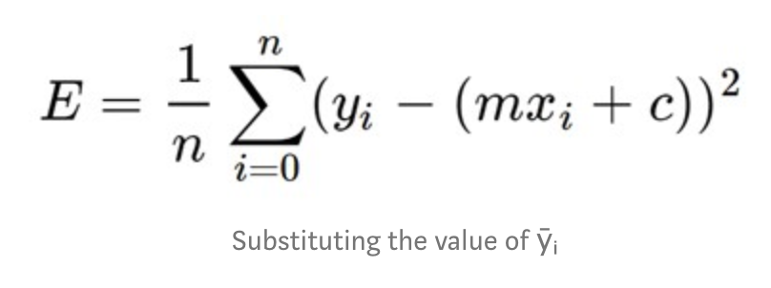
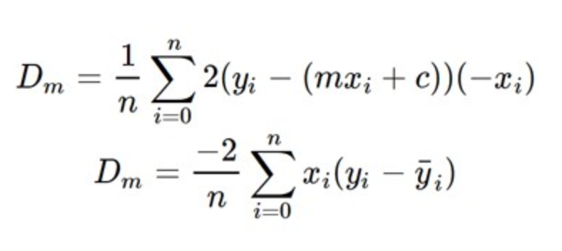
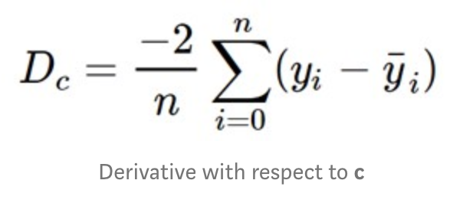
Gradient Descent Method: the mathematics
The loss function:
J
J(m,c)
n = number of samples
m
c
The slope in each point (m, c) of the “bowl” J in the 2 directions (m and c) are the derivatives

Slide 25
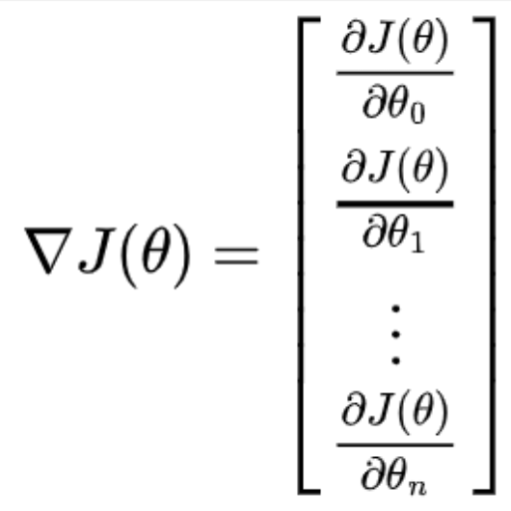
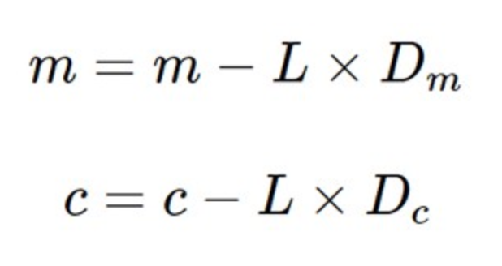
Gradient Descent Method: the mathematics
To sum up and clarify:
We need to start from initial values of m and c, then step by step move towards the minimum.
The derivative indicate us the direction of the fastest up-hill. Since we need to go downhill, we revert it with a minus sign.
J(m,c)
m
c
D is the derivative.
L is Learning rate

Slide 26
Intuitive explanation: 1 dimension
J
Suppose in P the derivative is -6. So (-1) * -6 = 6.
P
6
m
0,0

Slide 27
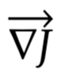
Intuitive explanation: 2 dimension
m
-
c
0,0

Slide 28

Q: What is gradient descent and
Learning rate?
Gradient Descent: is an optimization method for a function, where we would like to find the point of minimum. In fact, we start from a certain point (initialization point) and then, step by step, we move towards the minimum (local or global) using the direction of maximum down-hill. This direction is given by the derivative vector in the current point.
The learning rate L is “how big” the steps are: in fact, the step is proportional to the derivative multiplied by L. In some way L tells us the speed of learning.

Slide 29
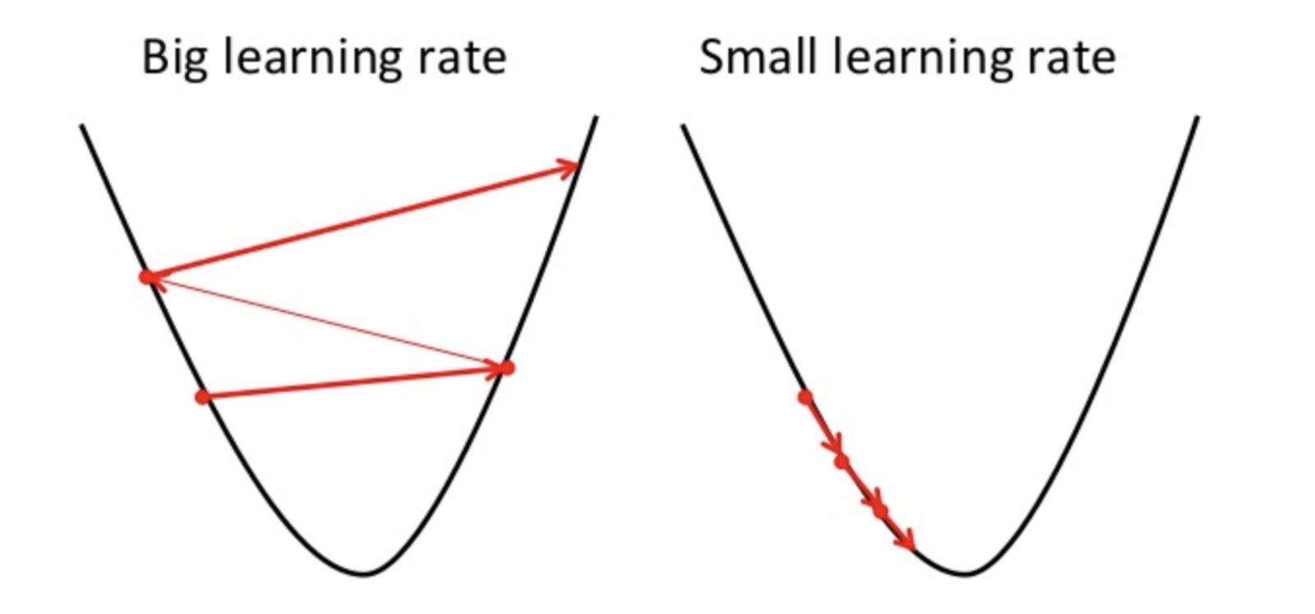
Overshooting? Problems with Gradient Descent
Gradient Descent is cool ! But it suffers from problems...what happens if we choose a Learning rate value too big? Overshooting!
Not OK
OK

Slide 30
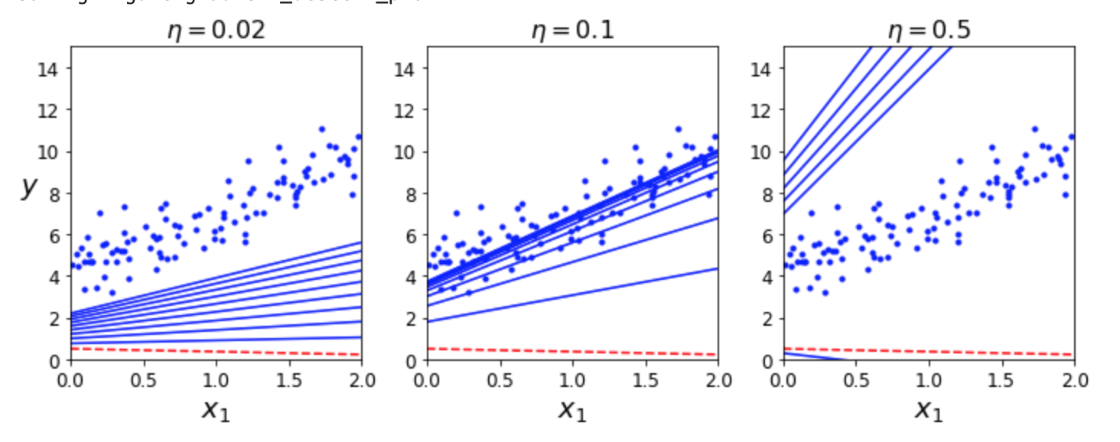
Overshooting? Learning rate too high!
Gradient Descent is cool ! But it suffers from problems...what happens if we choose a Learning rate value too big? Overshooting!

Slide 31
The important things to know: interview time
Remember: in an interview, the questions will be very generic. The general idea and intuition is often sufficient
Linear regression finds the mathematical function between an input (explanatory variables) and continuous values (dependent variable)
The output is a sum of weighted features (one or more than 1)
It can be solved with gradient descent Optimization Method or Normal Equation
The learning rate could lead to overshoot, so we have to choose it wisely
For the nature of the problem, the loss function has only 1 global minimum.

Slide 32
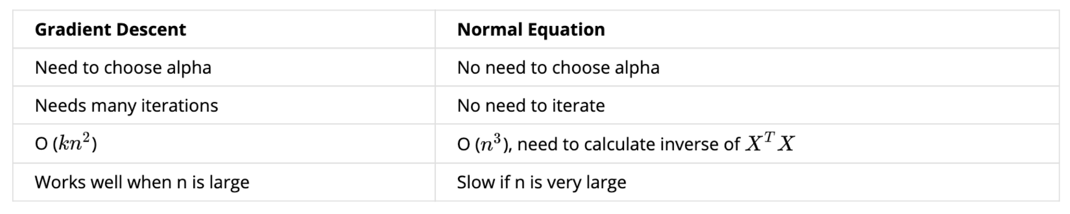
Methods used to solve linear regression
When to use what?
n is the number of features

Slide 33
3 flavours of Gradient Descent
Remember: in an interview, the questions will be very generic. The general idea and intuition is often sufficient
Batch Gradient Descent
Mini-Batch Gradient Descent
Stochastic Gradient Descent
The difference is simple: it depends on how many samples we use to calculate the derivative vector
In the Batch Gradient Descent, we use ALL data in the dataset to calculate the derivatives. Each step is done once the derivatives are calculated, using ALL the data available
In the Mini-Batch Gradient Descent, we use a portion of data in the dataset to calculate the derivatives. Each step is done once the derivatives are calculated, using ALL the data available
In the Stochastic Gradient Descent, we use ONE SAMPLE at the time to calculate the derivatives. Each step is done once the derivatives are calculated, using ALL the data available

Slide 34
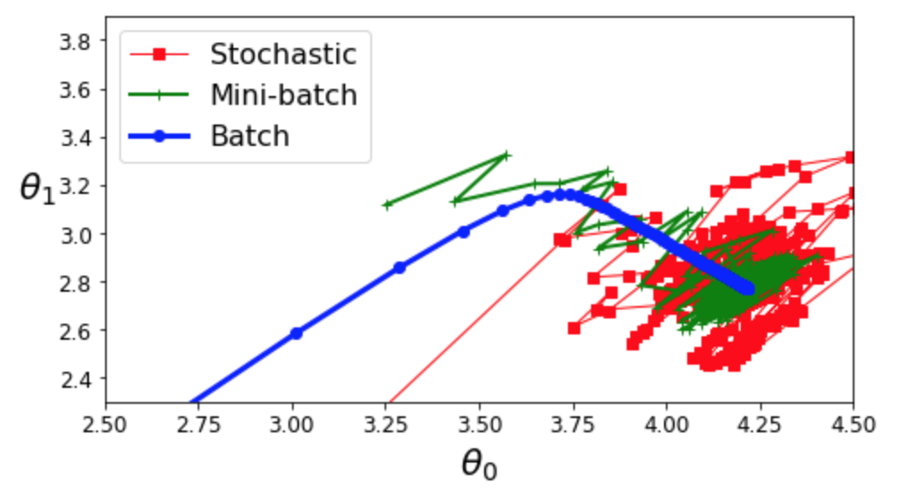
3 flavours of Gradient Descent
Remember: in an interview, the questions will be very generic. The general idea and intuition is often sufficient
With Mini-Batch or Stochastic GD you can implement ONLINE learning: you can train the model sample by sample (imagine you have a flow of data, arriving each second).
LINK

Slide 35
IMPORTANT: Scaling features for Linear Regression when use GRADIENT DESCENT
The data MUST BE transformed (normalized) before feeding to Linear Regression Model solved with gradient descent. With Normal Equation, we don’t need to normalize.
This is because the Loss Function can be distorted if not.
For example, image a dataset with 2 features:
The length of the ship (range of meters)
The diameter of a piston of the ship (range of centimeters)
In this case, the features are very different in scale, so the “diameter of the piston” risks to be under-represented by the final equation.
For this reason, it is correct to normalize the input features between 0 and 1 so that each feature is equally “important”.
More about this topic in a dedicated lesson about preprocessing of data, an important step before feeding data to models.

Slide 36

Sklearn: Linear Regression
Nobody implements Linear Regression by scratch, so we can also use Sklearn library to do it.

Slide 37
It’s your turn!
Open file called: LinearRegression.ipynb with Jupyter Notebook
Complete the Section_2

Slide 38
Break

Slide 39
Polynomial Regression
Is it possible to use a linear function to fit NON linear data?

Slide 40
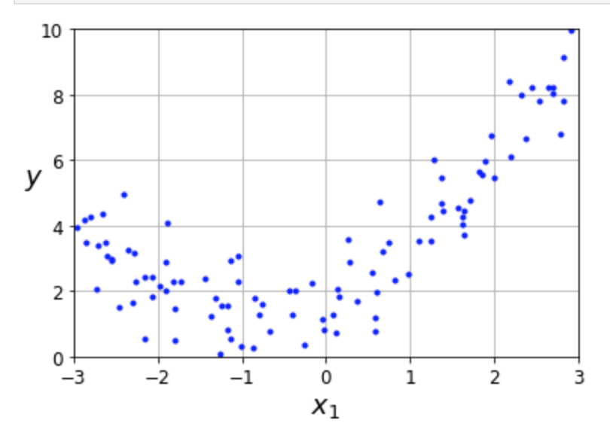
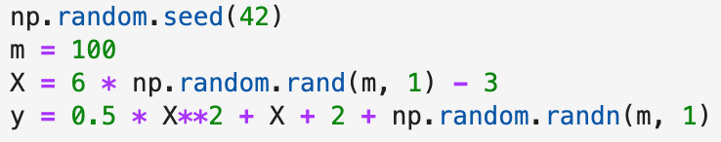
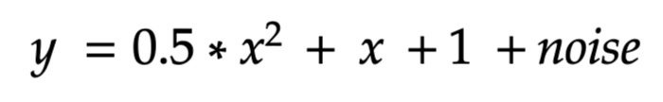
Polynomial Regression: can a Linear Model fit a non-linear function? YES!
No! A line is not a good fit for this data!
In fact, the data was generated with a quadratic function (parabola) in the form:

Slide 41
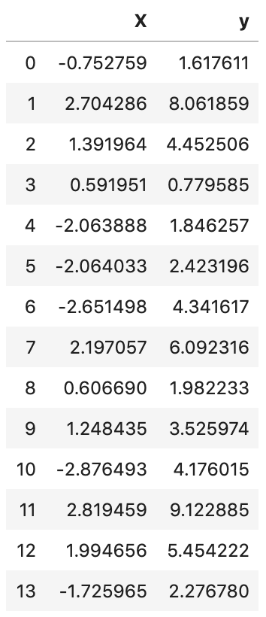
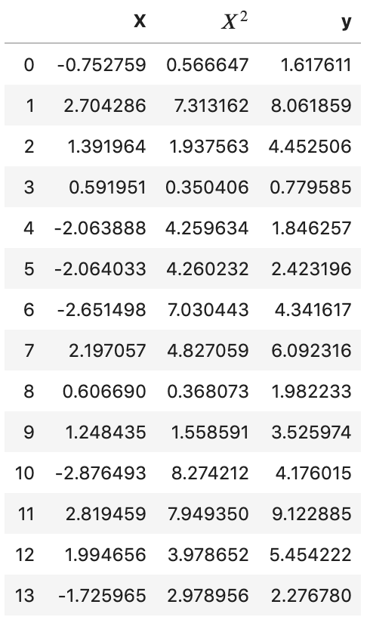
Dimensionality Expansion
Data can “live” in 2d space (x,y), but also in
3d space (x, x^2, y)
This means that we are applying a “Dimensionality Expansion” because we created a third dimension (X^2 that we can call as we want, for example Q) and “expand the data”.
Dimensionality Expansion
LINK - Parabola
LINK - Dimension Expansion

Slide 42
What is Polynomial Regression?
Remember: in an interview, the questions will be very generic. The general idea and intuition is often sufficient
When a relation x - y is not linear, we can expand the dimension of data and make them live in a higher degree space.
Polynomial regression can fit a non-linear problem but before transforming the problem in a space where it is linear.
The “Dimensionality Expansion” is a way to additional dimensions to a problem. For example, when we have 2d data (x, y coordinates), we can represent the same data in 3d, 4d, 5d...introducing additional features.
The most common in regression: create power of existing features

Slide 43
Exercise!
Please open notebook “Linear Regression”
Go to Section 3

